Slide 1
Meloun o hmotnosti 4 kg padá volným pádem z výšky 180 m v tíhovém poli Země.
Vytvořte graf závislosti
kinetické a potenciální energie
na čase a výšce.

Slide 2
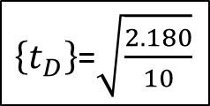
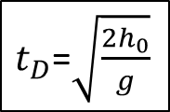
m/kg | h_{o}/m | t_{D}/s
4 | 180
$t_{D}$=$\sqrt{\frac{2h_{0}}{g}}$
$\left\{t_{D}\right\}$=$\sqrt{\frac{2.180}{10}}$
čas dopadu
t/s | h/m | v/ms⁻¹ | E_{P}/J | E_{K}/J | E/J
0
…

Slide 3
m/kg | h_{o}/m | t_{D}/s
4 | 180 | 6
t/s | h/m | v/ms⁻¹ | E_{P}/J | E_{K}/J | E/J
0
1
2
3
4
5
6

Slide 4
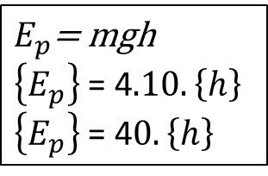
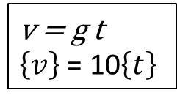
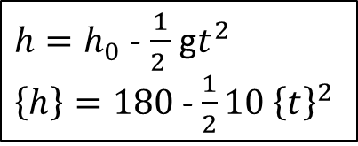

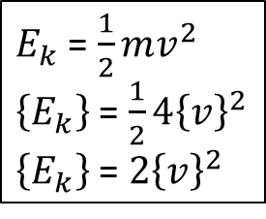
m/kg | h_{o}/m | t_{D}/s
4 | 180 | 6
výška
rychlost
potenciální energie
kinetická energie
mechanická energie
$h=h_{0}$ - $\frac{1}{2 }$ g$t^{2}$
$\left\{h\right\}=180$- $\frac{1}{2}10{ \left\{t\right\}}^{2}$
v = g t
$\left\{v\right\}$ = 10$\left\{t\right\}$
$E_{p}$= mgh
$\left\{E_{p}\right\}$ = 4$.10.\left\{h\right\}$
$\left\{E_{p}\right\}$ = 4$0.\left\{h\right\}$
$E_{k}$ = $\frac{1}{2}mv^{2}$
$\left\{E_{k}\right\}$ = $\frac{1}{2}4{\left\{v\right\}}^{2}$
$\left\{E_{k}\right\}$ = $2{\left\{v\right\}}^{2}$
${{E= E}_{k}+E}_{p}$

Slide 5
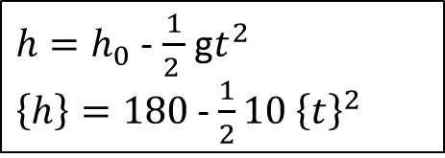
m/kg | h_{o}/m | t_{D}/s
4 | 180 | 6
výška
$h=h_{0}$ - $\frac{1}{2 }$ g$t^{2}$
$\left\{h\right\}=180$- $\frac{1}{2}10{ \left\{t\right\}}^{2}$
t | h | v | E_{P} | E_{K} | E
0
1
2
3
4
5
6
t | h | v | E_{P} | E_{K} | E
0 | 180
1 | 175
2 | 160
3 | 135
4 | 100
5 | 55
6 | 0

Slide 6

m/kg | h_{o}/m | t_{D}/s
4 | 180 | 6
rychlost
v = g t
$\left\{v\right\}$ = 10$\left\{t\right\}$
t | h | v | E_{P} | E_{K} | E
0 | 180
1 | 175
2 | 160
3 | 135
4 | 100
5 | 55
6 | 0
t | h | v | E_{P} | E_{K} | E
0 | 180 | 0
1 | 175 | 10
2 | 160 | 20
3 | 135 | 30
4 | 100 | 40
5 | 55 | 50
6 | 0 | 60

Slide 7
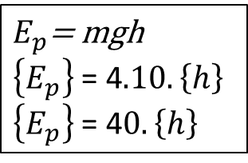
m/kg | h_{o}/m | t_{D}/s
4 | 180 | 6
potenciální energie
$E_{p}$= mgh
$\left\{E_{p}\right\}$ = 4$.10.\left\{h\right\}$
$\left\{E_{p}\right\}$ = 4$0.\left\{h\right\}$
t | h | v | E_{P} | E_{K} | E
0 | 180 | 0
1 | 175 | 10
2 | 160 | 20
3 | 135 | 30
4 | 100 | 40
5 | 55 | 50
6 | 0 | 60
t | h | v | E_{P} | E_{K} | E
0 | 180 | 0 | 7200
1 | 175 | 10 | 7000
2 | 160 | 20 | 6400
3 | 135 | 30 | 5400
4 | 100 | 40 | 4000
5 | 55 | 50 | 2200
6 | 0 | 60 | 0

Slide 8
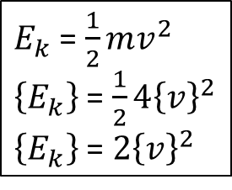
$E_{k}$ = $\frac{1}{2}mv^{2}$
$\left\{E_{k}\right\}$ = $\frac{1}{2}4{\left\{v\right\}}^{2}$
$\left\{E_{k}\right\}$ = $2{\left\{v\right\}}^{2}$
m/kg | h_{o}/m | t_{D}/s
4 | 180 | 6
kinetická energie
t | h | v | E_{P} | E_{K} | E
0 | 180 | 0 | 7200
1 | 175 | 10 | 7000
2 | 160 | 20 | 6400
3 | 135 | 30 | 5400
4 | 100 | 40 | 4000
5 | 55 | 50 | 2200
6 | 0 | 60 | 0
t | h | v | E_{P} | E_{K} | E
0 | 180 | 0 | 7200 | 0
1 | 175 | 10 | 7000 | 200
2 | 160 | 20 | 6400 | 800
3 | 135 | 30 | 5400 | 1800
4 | 100 | 40 | 4000 | 3200
5 | 55 | 50 | 2200 | 5000
6 | 0 | 60 | 0 | 7200

Slide 9

m/kg | h_{o}/m | t_{D}/s
4 | 180 | 6
mechanická energie
${{E= E}_{k}+E}_{p}$
t | h | v | E_{P} | E_{K} | E
0 | 180 | 0 | 7200 | 0
1 | 175 | 10 | 7000 | 200
2 | 160 | 20 | 6400 | 800
3 | 135 | 30 | 5400 | 1800
4 | 100 | 40 | 4000 | 3200
5 | 55 | 50 | 2200 | 5000
6 | 0 | 60 | 0 | 7200
t | h | v | E_{P} | E_{K} | E
0 | 180 | 0 | 7200 | 0 | 7200
1 | 175 | 10 | 7000 | 200 | 7200
2 | 160 | 20 | 6400 | 800 | 7200
3 | 135 | 30 | 5400 | 1800 | 7200
4 | 100 | 40 | 4000 | 3200 | 7200
5 | 55 | 50 | 2200 | 5000 | 7200
6 | 0 | 60 | 0 | 7200 | 7200

